Slide 1

Applied Distributed Systems
Container Management

Slide 2
Overview
Container repositories
Clusters and orchestration
Serverless Architecture

Slide 3
Container repositories
Container images are typically stored in repositories
Similar to version control systems
Accessible with permissions
Push/pull interface
Images can be tagged with version numbers

Slide 4
Docker Hub
Docker Hub is a publicly available repository.
Since it is open source, It is also used for private container repositories
It is the most widely used container repository

Slide 5
Integrating with development workflow
Multiple team members may wish to share images
Images can be in production, under development or under test
Private container repository allows images to be stored and shared.
Any image can be “pulled” to any host
Tagging as “latest” allows updates to be propagated. Pull <image name>:latest gets the last image checked into repository with that name.

Slide 6
Overview
Container repositories
Clusters and orchestration
Serverless Architecture

Slide 7
Grouping containers
Up to this point, containers are arbitrarily assigned to available host without regard for communication among containers.
Suppose two containers communicate frequently. E.g. app container and logging containers. Then you would like them to be allocated into same host to reduce communication time.
This is rationale for “pods” (also called a “sidecar”)
A pod is a group of containers treated as a single unit for allocation.

Slide 8
Container hierarchy (again)
Container1
Container 2
Container 3
Container Runtime Engine
Operating System
Hypervisor or Bare Metal

Slide 9
Adding pods to hierarchy
Container 1
Container 3
Container 2
Pod 1
Pod 2
Host

Slide 10
Revisiting container hierarchy
Container1
Container 2
Container 3
Pod 1
Pod 2
Container Runtime Engine
Operating System
Hypervisor or Bare Metal

Slide 11
Revisiting container hierarchy
Container1
Container 2
Container 3
Pod 1
Pod 2
Container Runtime Engine
Operating System
Hypervisor or Bare Metal

Slide 12
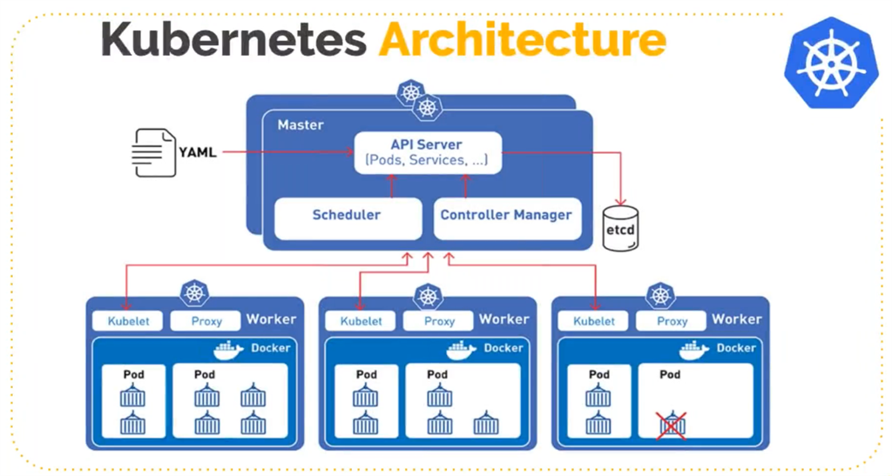
Kubernetes Architecture

Slide 13
Kubernetes Nodes
A pod runs on a Node. A node may be a virtual or physical machine, depending on the cluster.
A cluster is a set of nodes
Each node contains the services necessary to run pods.
Master node provides management functions
Worker nodes contain pods

Slide 14
Running applications
Controlling an application is done through the Kubernetes master
Monitoring containers and pods
Scaling pods
Interacting with an application is done through sending messages to containers.

Slide 15
Scaling
Master is responsible for autoscaling.
Allocation is done by pods, not containers.
Autoscaling pods is similar to autoscaling VMs in the cloud.

Slide 16
Overview
Container repositories
Clusters and orchestration
Serverless Architecture

Slide 17
Serverless
Cloud providers such as AWS maintain pool of partially loaded containers that only require application specific layer. The term “serverless” is used to describe these partially loaded containers.
Load in milli secs.
For AWS, only one request per instance.
Impacts architecture of application.

Slide 18
Summary
Repositories of container images act much like version control systems
Kubnetes is a manager for containers that utilizes pods.
Serverless architecture takes advantage of fast load time of container images but with restrictions on usage.

